Slide 1
Program Compliance Reviews A New View
2017 Annual IFTA Business Meeting
August 9-10, 2017
Chandler, AZ
Presented by:
Tim Ford, PCRC Chair
John Szilagyi, PCRCWG Chair
Rick LaRose, PCRC Board Liaison

Slide 2
Program Compliance Reviews A New View
The Old Way…
Labor Intensive for Jurisdiction, Review Team and PCRC
The citings are all inclusive
The Process is SLOW

Slide 3
Program Compliance Reviews A New View
A New Way…
Use the information you already upload in the Clearinghouse
Speed up the process

Slide 4
Program Compliance Reviews A New View
How did we get here?
R1555
Creation of the PCRCWG
The Survey
PCRC and WG Face to Face in Chandler

Slide 5
Program Compliance Reviews A New View
What is it all about? The highlights:
Review Cycle changes to three years
Audit Accountability remains at five years
Use the information contained in the Clearinghouse – Transmittals and Audit Reports

Slide 6
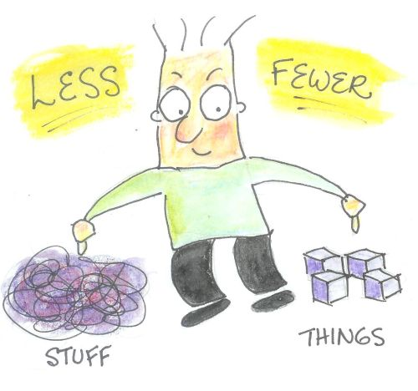
Program Compliance Reviews A New View
What does this mean to my Jurisdiction?
No retrieval, scanning and uploading of audit files and returns
Quicker, less intrusive review
Fewer resources dedicated by your Jurisdiction

Slide 7
Program Compliance Reviews A New View
What happens if the Review Team finds something?
Expect a phone call
May require the upload of additional information (Audit File)

Slide 8
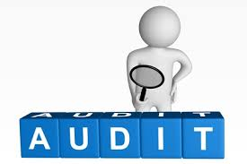
Program Compliance Reviews A New View
OK…What about the Audits?
Audit reviews will be based on information contained in the Audit Report uploaded to the Clearinghouse
Additional information may be required if there are questions found in the Audit Report (This means uploading the Audit File)

Slide 9
Program Compliance Reviews A New View
OK…What about the Audits? (cont.)
Audit quality goes beyond the PCR process. It is up to the jurisdictions to protect their revenue. Once the audit goes beyond the 45 day appeal date the audit becomes final. Neither the PCRC nor Review Team can change any audit numbers, especially if they are looking at an audit 3 years later.

Slide 10
Thoughts?
Focus Reviews on R1555
Utilize information in Clearinghouse
Fewer Jurisdiction resources
Continued verification of Compliance

Slide 11
What’s Next…
Review feedback from ABM
Ratification by Membership

